Slide 1

Hospital DRG Payment Analysis​
Applied Business Analytics​
BAN5650​
Team Grand
Jigyansha Dahal​
Rojina Sapkota ​
Veerasaimohit Dandu​

Slide 2

Methodology​
Rndrng_Prvdr_State_Abrvtn = MA​
Combined 2019 and 2021 data​
Concatenated DRG codes and DRG Description​
Complied all DRGs from 2019 and 2021 data​
Grouped Total Discharges and Average Total Payment for respective years​
Effect of service mix change​
2021 service mix​
2021 service mix on 2019 total discharges (How many hospitalizations would there have been in 2021 if we had considered total hospitalization volume from 2019?)​
2019 average total payment​
Cost using 2019 average total payment and 2021 service mix on 2019 total discharge​
2019 average payment at 2019 service mix​
Impact of service change​
Effect of individual average DRG payment​
​
​

Slide 3
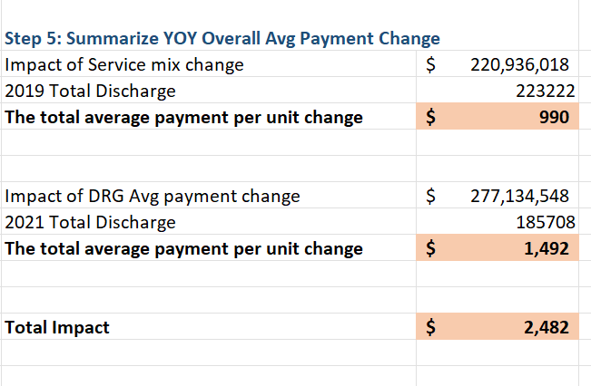
CHANGE IN AVERAGE MEDICARE REIMBURSEMENT IN MASSACHUSETTS (2019 – 2021)​
​
60% of the increase in overall average payment was due to change in individual DRG payments​
​
40% of the increase in overall average payment was due to change in service mix​

Slide 4
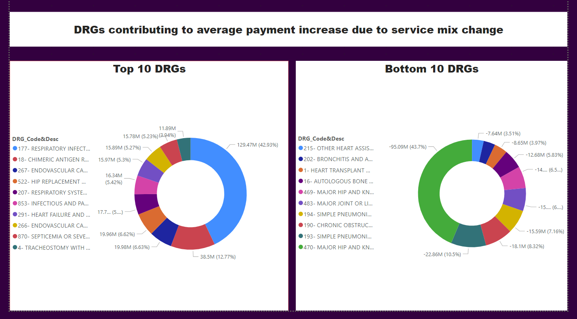

Slide 5
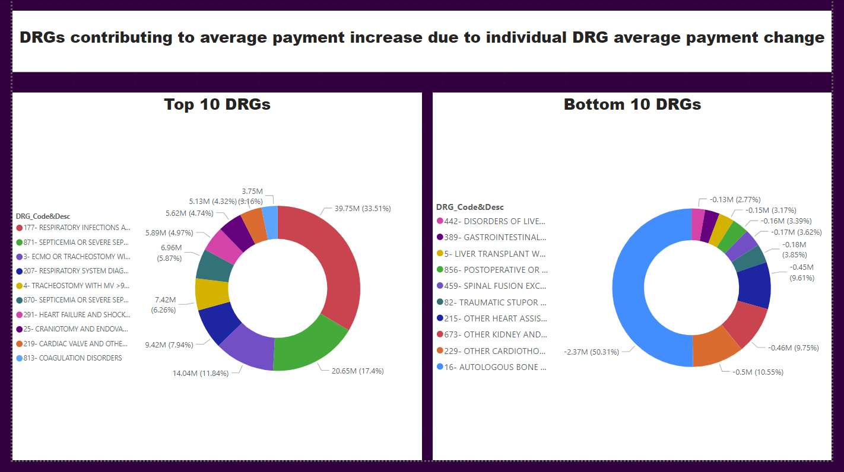

Slide 6

Medicare reimbursement rate setting process ensures covering the costs that "reasonably efficient providers would incur in furnishing high-quality care" (Medpac, 2019).​
Higher average Medicare reimbursement rates imply there has been a change in the costs as indicated above.​
When Hospitals optimize their service mix within their DRGs to deliver high-reimbursing services, efficiently manage resources, enhance quality of care, they improve the patient outcomes.​
Hospitals benefit from an improved negotiation power when dealing with various stakeholders, including hospital agents and payers. ​
Acquisition
Decisions​

Slide 7
Hospitals with better negotiation power attract and retain skilled healthcare professionals aiding to boost their brand value​
​
Better standing in the community helps these hospitals attract Medicare beneficiaries when combined with the fact that 60% of the change in overall average payment was induced by change in individual average DRG payment.​
​
This means increased revenue and increased profit margin if these hospitals efficiently manage their resources.​
​
Acquiring hospitals in MA could be a good opportunity to explore.​
Acquisition
Decisions​

Slide 8

REFRENCES
Medical Payment Advisory Commission. (March, 2019). Report to the Congress: Medicare Payment Policy.​
https://www.medpac.gov/document/march-2019-report-to-the-congress-medicare-payment-policy/​

Slide 9
Thank
You

